Slide 1


Minority Serving Institutions under Trump’s Presidency
Andrés Castro Samayoa, Ph.D. (Boston College)
@andrescastrosam
andres.castrosamayoa@bc.edu
September 25, 2018

Slide 2
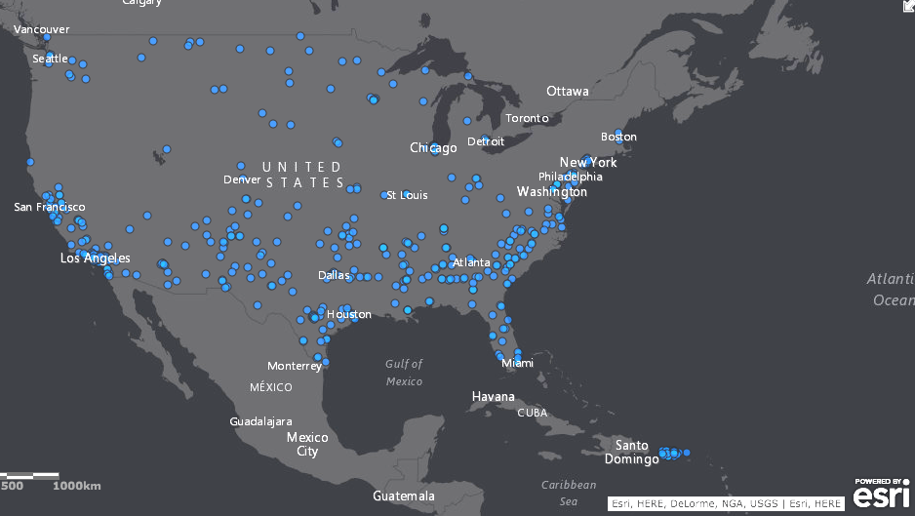

Slide 3
Asian American Native American Pacific Islander Serving Institutions
Historically Black Colleges & Universities
Hispanic Serving Institutions
Tribal Colleges & Universities
Predominantly Black Institutions
Native American Non-Tribal Serving Institutions
Alaska Native Serving Institutions
Native Hawaiian Serving Institutions

Slide 4
Account for ~15% of postsecondary institutions in the nation
Enroll ~40% of students of color
  Note that HSIs alone enroll over 60% of Latinos in college
  (Conrad & Gasman, 2015; Castro Samayoa & Gasman, in press; Dwyer & Garcia, 2018)

Slide 5
Table IV.2. Overview of Appropriations for Minority Serving Institutions in FY2018
Authorizing Legislation | Name of Grant | FY 2017 Enacted | FY 2018 Presidential Request | Final Bill
HEA Part III-A | Strengthening Institutions Program | $ 86,534 |  | $ 98,886
HEA Part V-A | Strengthening Hispanic Serving Institutions | $ 107,795 | $ 107,590 | $ 123,183
HEA Part V-B(512) | Promoting Postbaccalaureate Opportunities for Hispanic Americans | $ 9,671 | $ 9,653 | $ 11,052
HEA Part III-B-323 | Strengthening Historically Black Colleges & Universities | $ 244,694 | $ 244,229 | $ 279,624
HEA Part III-B-326 | Strengthening Historically Black Graduate Institutions | $ 63,281 | $ 63,161 | $ 72,314
HEA Part III-A-318 | Strengthening Predominately Black Institutions | $ 9,942 | $ 9,923 | $ 11,361
HEA Part III-A-320 | Strengthening Asian American Pacific Islander Serving Institutions | $ 3,348 | $ 3,342 | $ 3,826
HEA Part III-A-317 | Strengthening Alaska Native & Native Hawaiian Serving Institutions | $ 13,802 | $ 13,776 | $ 15,772
HEA PartIII-A-319 | Strengthening Native American-Serving Non-Tribal Institutions | $ 3,348 | $ 3,342 | $ 3,826
HEA Part III-A-316 | Strengthening Tribally-Controlled Colleges and Universities | $ 27,599 | $ 27,547 | $ 31,539
HEA Part VII A-4-723 | Strengthening Master's Degree Programs at HBCUs | $ 7,500 |  | $ 8,571
 | Subtotal, Aid for Institutional development | $ 577,514 | $ 482,563 | $ 659,954
(HEA = Higher Education Act; amount in thousands)
Sources: S. Rep. No. 115-150, at 185 (2017); H. Rep. 115-244, at 125 (2017); 164 Cong. Rec. H2766 (2018).

Slide 6
Table IV.2. Overview of Appropriations for Minority Serving Institutions in FY2018
Authorizing Legislation | Name of Grant | FY 2017 Enacted | FY 2018 Presidential Request | Final Bill
HEA Part III-A | Strengthening Institutions Program | $ 86,534 |  | $ 98,886
HEA Part V-A | Strengthening Hispanic Serving Institutions | $ 107,795 | $ 107,590 | $ 123,183
HEA Part V-B(512) | Promoting Postbaccalaureate Opportunities for Hispanic Americans | $ 9,671 | $ 9,653 | $ 11,052
HEA Part III-B-323 | Strengthening Historically Black Colleges & Universities | $ 244,694 | $ 244,229 | $ 279,624
HEA Part III-B-326 | Strengthening Historically Black Graduate Institutions | $ 63,281 | $ 63,161 | $ 72,314
HEA Part III-A-318 | Strengthening Predominately Black Institutions | $ 9,942 | $ 9,923 | $ 11,361
HEA Part III-A-320 | Strengthening Asian American Pacific Islander Serving Institutions | $ 3,348 | $ 3,342 | $ 3,826
HEA Part III-A-317 | Strengthening Alaska Native & Native Hawaiian Serving Institutions | $ 13,802 | $ 13,776 | $ 15,772
HEA PartIII-A-319 | Strengthening Native American-Serving Non-Tribal Institutions | $ 3,348 | $ 3,342 | $ 3,826
HEA Part III-A-316 | Strengthening Tribally-Controlled Colleges and Universities | $ 27,599 | $ 27,547 | $ 31,539
HEA Part VII A-4-723 | Strengthening Master's Degree Programs at HBCUs | $ 7,500 |  | $ 8,571
 | Subtotal, Aid for Institutional development | $ 577,514 | $ 482,563 | $ 659,954
(HEA = Higher Education Act; amount in thousands)
Sources: S. Rep. No. 115-150, at 185 (2017); H. Rep. 115-244, at 125 (2017); 164 Cong. Rec. H2766 (2018).

Slide 7
Table IV.3. Overview of Proposed Appropriations for Minority Serving Institutions in FY2019
Authorizing Legislation | Name of Grant | Presidential Request | U.S. Senate Proposed | U.S. House of Representatives Proposed
HEA Part III-A | Strengthening Institutions Program | $ - | $ 101,067 | $ 98,886
HEA Part V-A | Strengthening Hispanic Serving Institutions | $ - | $ 125,898 | $ 123,183
HEA Part V-B(512) | Promoting Postbaccalaureate Opportunities for Hispanic Americans | $ - | $ 11,296 | $ 11,052
HEA Part III-B-323 | Strengthening Historically Black Colleges & Universities | $ 244,694 | $ 285,788 | $ 279,624
HEA Part III-B-326 | Strengthening Historically Black Graduate Institutions | $ 63,281 | $ 73,908 | $ 72,314
HEA Part III-A-318 | Strengthening Predominately Black Institutions | $ - | $ 11,611 | $ 11,361
HEA Part III-A-320 | Strengthening Asian American Pacific Islander Serving Institutions | $ - | $ 3,910 | $ 3,826
HEA Part III-A-317 | Strengthening Alaska Native & Native Hawaiian Serving Institutions | $ - | $ 16,120 | $ 15,772
HEA PartIII-A-319 | Strengthening Native American-Serving Non-Tribal Institutions | $ - | $ 3,910 | $ 3,826
HEA Part III-A-316 | Strengthening Tribally-Controlled Colleges and Universities | $ 27,599 | $ 32,234 | $ 31,539
HEA Part VII A-4-723 | Strengthening Master's Degree Programs at HBCUs | $ 7,500 | $ 8,760 | $ 8,571
 | Subtotal for Institutional Aid | $ 343,074 | $ 674,502 | $ 659,954
(HEA = Higher Education Act; in Thousands)
Sources: S. Rep 115-289, at 202 (2018); H. Rep. 115-862, at 150 (2018); Presidential FY 2019 Budget Summary and Background Information; Presidential FY 2019 Budget Request for Higher Education

Slide 8
Reauthorization of HEA…
PROSPER Act
  25% graduation measures
Aim Higher Act
  MSI Innovation Fund
Neither resolves eligibility for multiple grants

