Slide 1
Asian Americans and Race-Conscious Admission: Understanding the Conservative Opposition’s Strategy of Misinformation and Racial Division
OiYan Poon, Ph.D.
Assistant Professor, Higher education leadership
Director, Center for racial Justice in Education & Research
Co-Author: Dr. Liliana Garces (University of Texas at Austin)

Slide 2
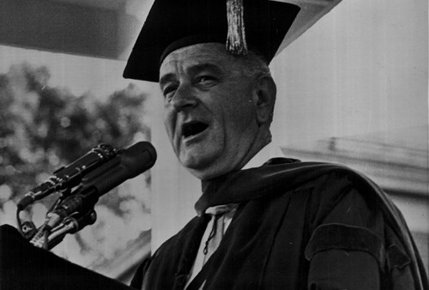
Original goal of affirmative action
Equal Access
Level the playing field
President Johnson, 1965
Notes:
The first part of our report reviews the legal history of race-conscious admissions.
LBJ (1965): You do not take a person who, for years, has been hobbled by chains and liberate him, bring him up to the starting line of a race and then say “you are free to compete with all others,” and still justly believe that you have been completely fair. Thus it is not enough just to open the gates of opportunity. All our citizens must have the ability to walk through those gates.

Slide 3
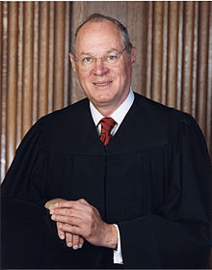
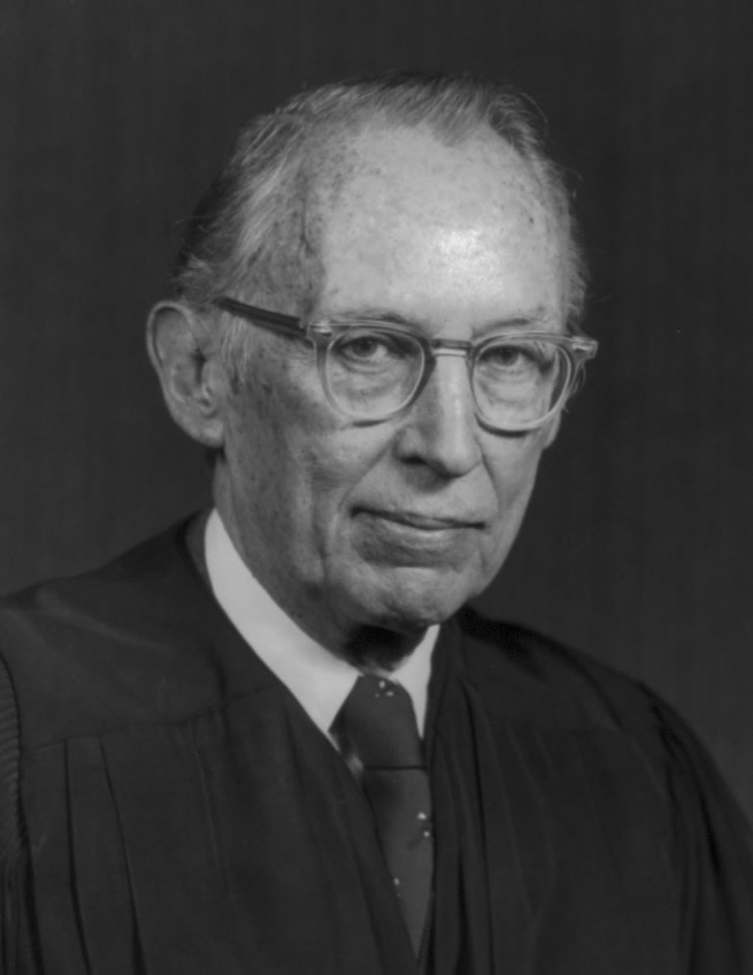
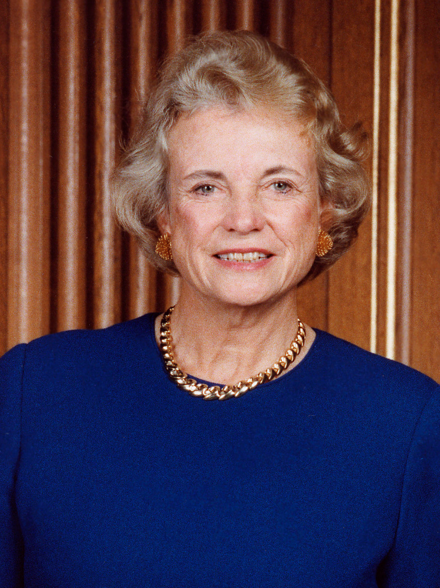
Legal Rationale: Diversity
Justice O’Connor
Grutter (2003):
Reaffirmed diversity rationale.
Race can be one of many factors considered.
Gratz (2003):
Point systems are unconstitutional – too inflexible.
Justice Kennedy
Fisher II (2016):
Reaffirmed diversity rationale.
Reaffirmed: Race can be one of many factors considered, particularly in holistic review.
Justice Powell (Bakke, 1978)
Diversity rationale
Quotas are unconstitutional.
Notes:
Since the establishment of affirmative action principles in the 1960s, the legal justification, or compelling interest for race-conscious admission has shifted from advancing racial equity…
-to the diversity rationale, which was first articulated by Justice Powell in the 1978 Bakke case, which also declared racial quotas unconstitutional.
-the diversity rationale was reaffirmed in the Grutter case → race as one of many factors; in other Michigan case (Gratz), point systems ruled unconstitutional.
-Then in 2016 in the Fisher case, Justice Kennedy again reaffirmed the diversity rationale and that race can be one of many factors considered holistically.

Slide 4

Asians are being used to make the case against affirmative action. Again. – Alvin Chang in Vox (3.28.2018)
Notes:
The remainder of our report addresses the racial politics behind attacks on affirmative action today. What we are seeing today, with Ed Blum’s SFA v. Harvard case and the Trump administration roll-back of Obama era guidance and DOJ investigation into race-conscious admissions, is a long standing racial strategy of using Asian Americans as a racial mascot.
In the 1980s-legit concerns of discrimination among Asian American college students at Brown, Harvard, Princeton, Stanford, Yale, Berkeley and UCLA accused their universities of placing illegal ceilings on the number of ASAMS admitted in favor of whites w/same qualifications.
These concerns about discrimination are not the same as being concerned about or opposed to affirmative action.
However, affirmative action opponents in the 1980s, as they are today, are manipulatively using Asian Americans as a racial mascot
-pitting them against other people of color
-to continue rolling back civil rights policies for racial equity.
Notably in the SFA v. Harvard case, Ed Blum who filed the case has been unable to find ANY Asian American to testify in court that race-conscious admissions has harmed them. Additionally, Blum himself is resistant to testify in his court case. It is a classic case of racial mascotting.

Slide 5
Asian Americans on the whole support affirmative action
Asian American voters:
1996: 61% opposed Prop 209 in California
2006: 75% opposed Prop 2 in Michigan
62.6% of Asian American undergraduates support affirmative action (Park, 2009).
Notes:
The fact that not one Asian American is slated to testify in the Harvard case likely reflects the reality that most Asian Americans remain supportive of affirmative action.
Chinese Americans represent about 23% of the Asian American population, meaning that their opposition to the policy is in no way representative of the opinions of the broader Asian American population.

Slide 6
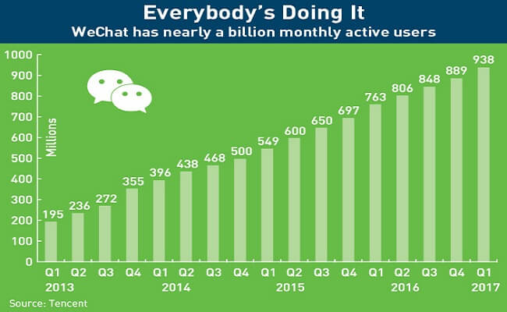
Recent Rise of Chinese American immigrant Conservative Activism
FOUR EXPLANATIONS:
1990 Immigration Act
PRC: Exam-focused & ethno-nationalistic ed structural context
Social segregation
WeChat (founded in 2011) – echo chamber of fake news
Notes:
So what might explain Chinese American opposition to affirmative action, which is a relatively new phenomenon?

Slide 7
MEDIA MISREPRESENTATIONS and PUBLIC MISINFORMATION
Recent Chinese American immigrants are not representative of all “Asian Americans”
Lack of understanding of how race conscious admissions works among both affirmative action supporters and opponents.

