Slide 1
How accountability can increase racial inequality: The case of federal risk-sharing
Nicholas Hillman University of Wisconsin-Madison 9/25/2018

Slide 2
Policy context
Public concern about growth and consequences of student loan debt
Are we putting enough pressure on colleges to improve loan outcomes?
Federal “risk-sharing” proponents would say no
We need to fine colleges according to loan repayment rates

Slide 3
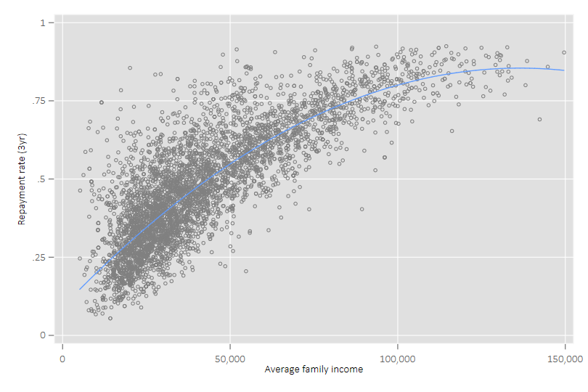
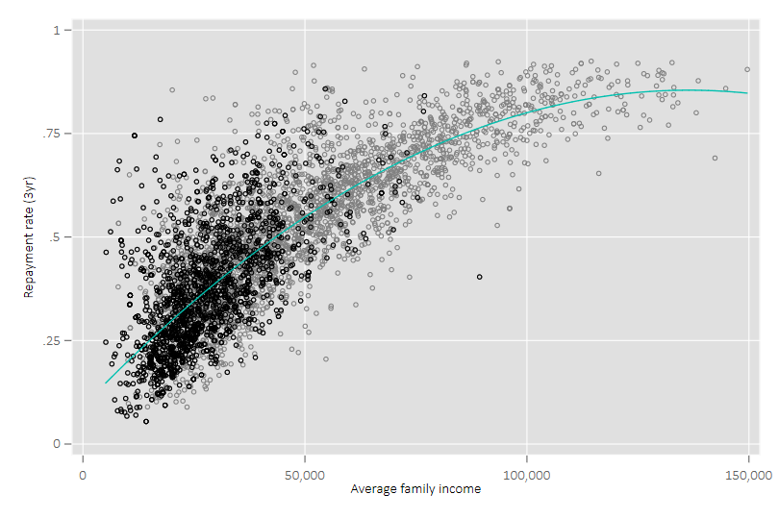
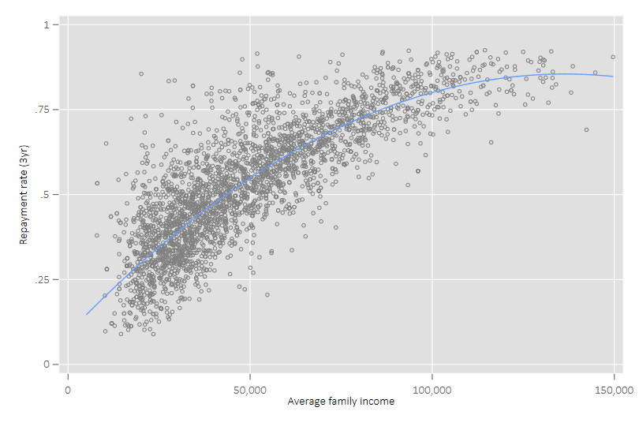
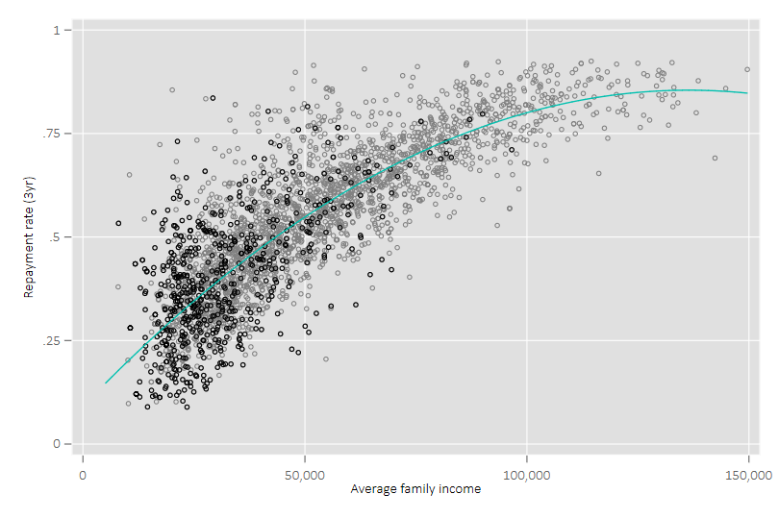
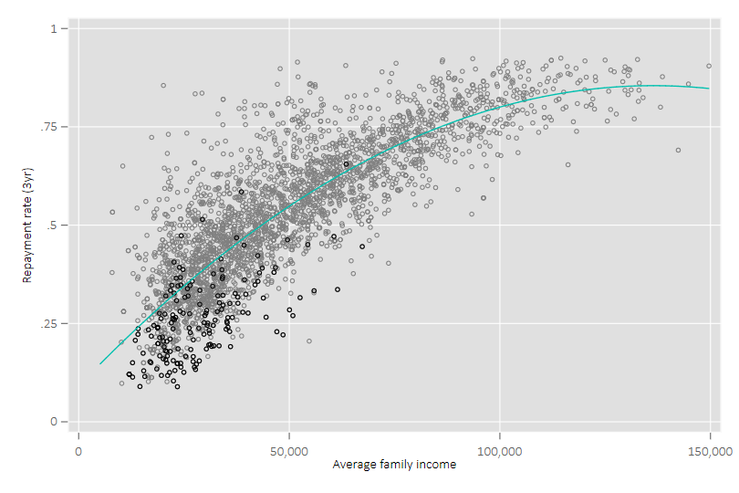
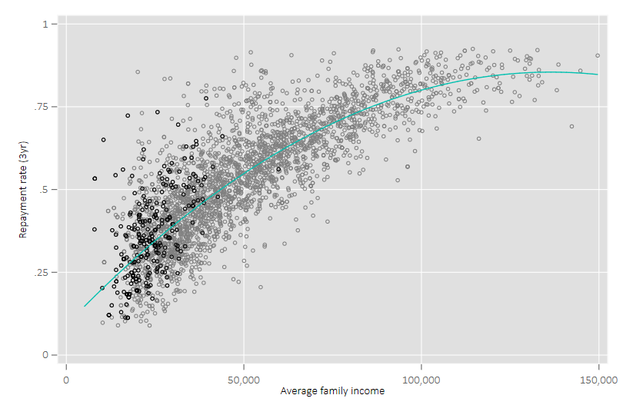
Repayment, income, & race are highly correlated
All colleges
For-profits
All public/NPs
All MSIs
HBCUs & PBIs
Highest First-Gen
All colleges
All colleges
For-profits
All public/NPs
All MSIs
HBCUs & PBIs
Highest First-Gen
All colleges
All colleges
For-profits
All public/NPs
All MSIs
HBCUs & PBIs
Highest First-Gen
All colleges
All colleges
For-profits
All public/NPs
All MSIs
HBCUs & PBIs
Highest First-Gen
All colleges
All colleges
For-profits
All public/NPs
All MSIs
HBCUs & PBIs
Highest First-Gen
All colleges
All colleges
For-profits
All public/NPs
All MSIs
HBCUs & PBIs
Highest First-Gen
All colleges
All colleges
For-profits
All public/NPs
All MSIs
HBCUs & PBIs
Highest First-Gen
All colleges
Source: College Scorecard

Slide 4
A fairer way to improve repayment
Penalizing colleges for inequality will only reinforce it
What specific actions will improve repayment?
- Don’t use repayment for accountability if you can’t answer this
Promising ways forward:
- Repayment improvement fund
- Build campus & students’ capacity to improve outcomes
- Comprehensive, community-based solutions
- Technical assistance labs

