Slide 1
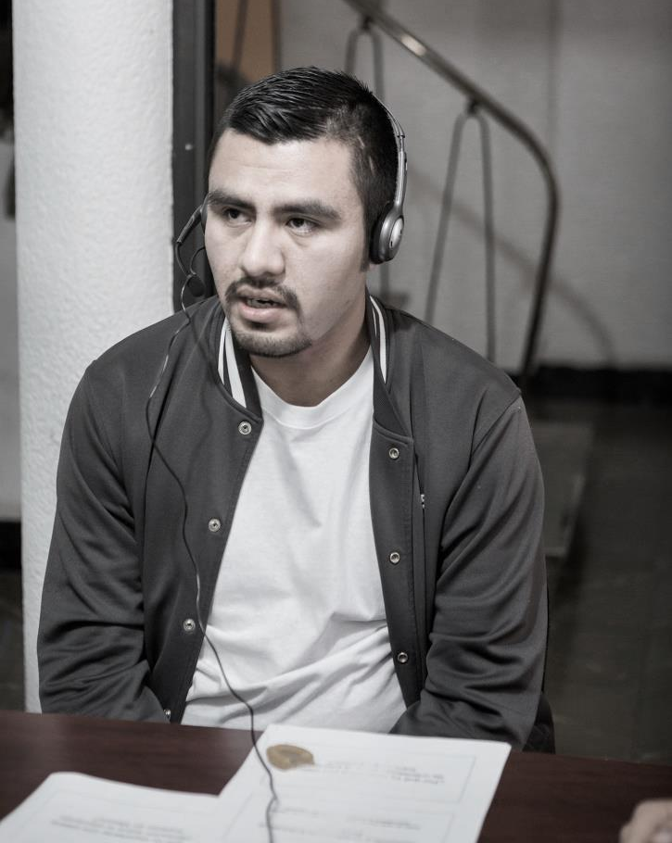

Christian Galvan
From:
Mexico City – New York
Major: Biology

Slide 2
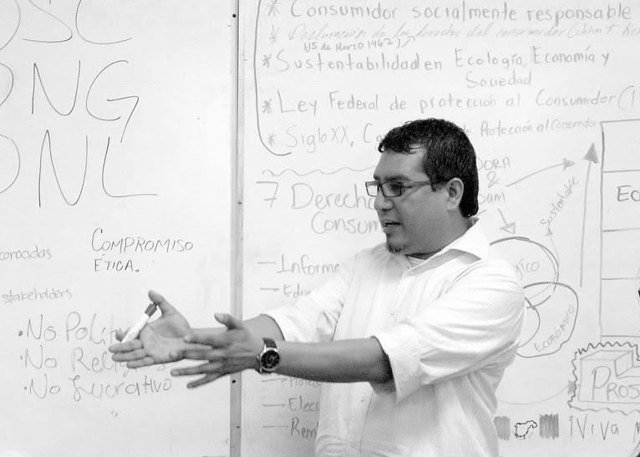
Freddi Garcia
From:
Mexico City – California
Major: Sociology

Slide 3
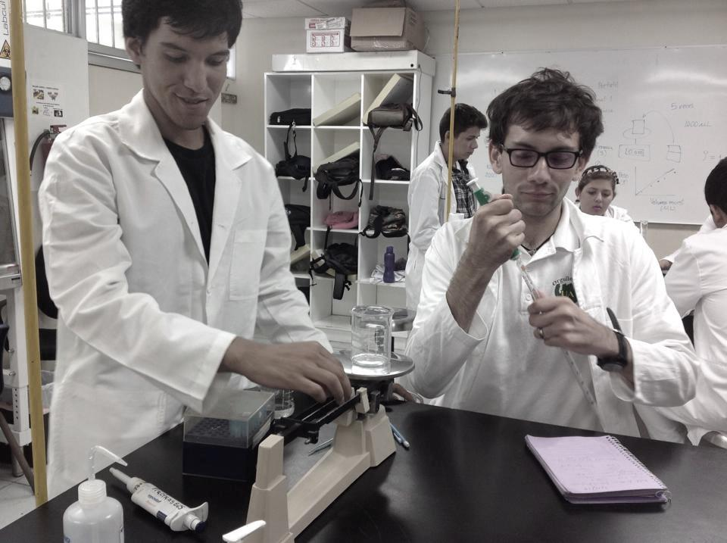
Raziel Ramos Jaramillo
From:
Baja California – Arizona
Major: Medicine

Slide 4
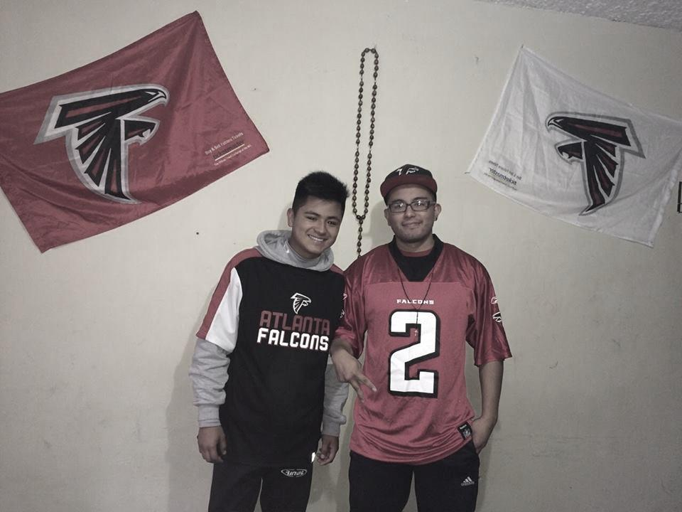
Manuel and Alejandro Torres
From:
Mexico City – Georgia
Pursuing: IT Industry / high school

Slide 5
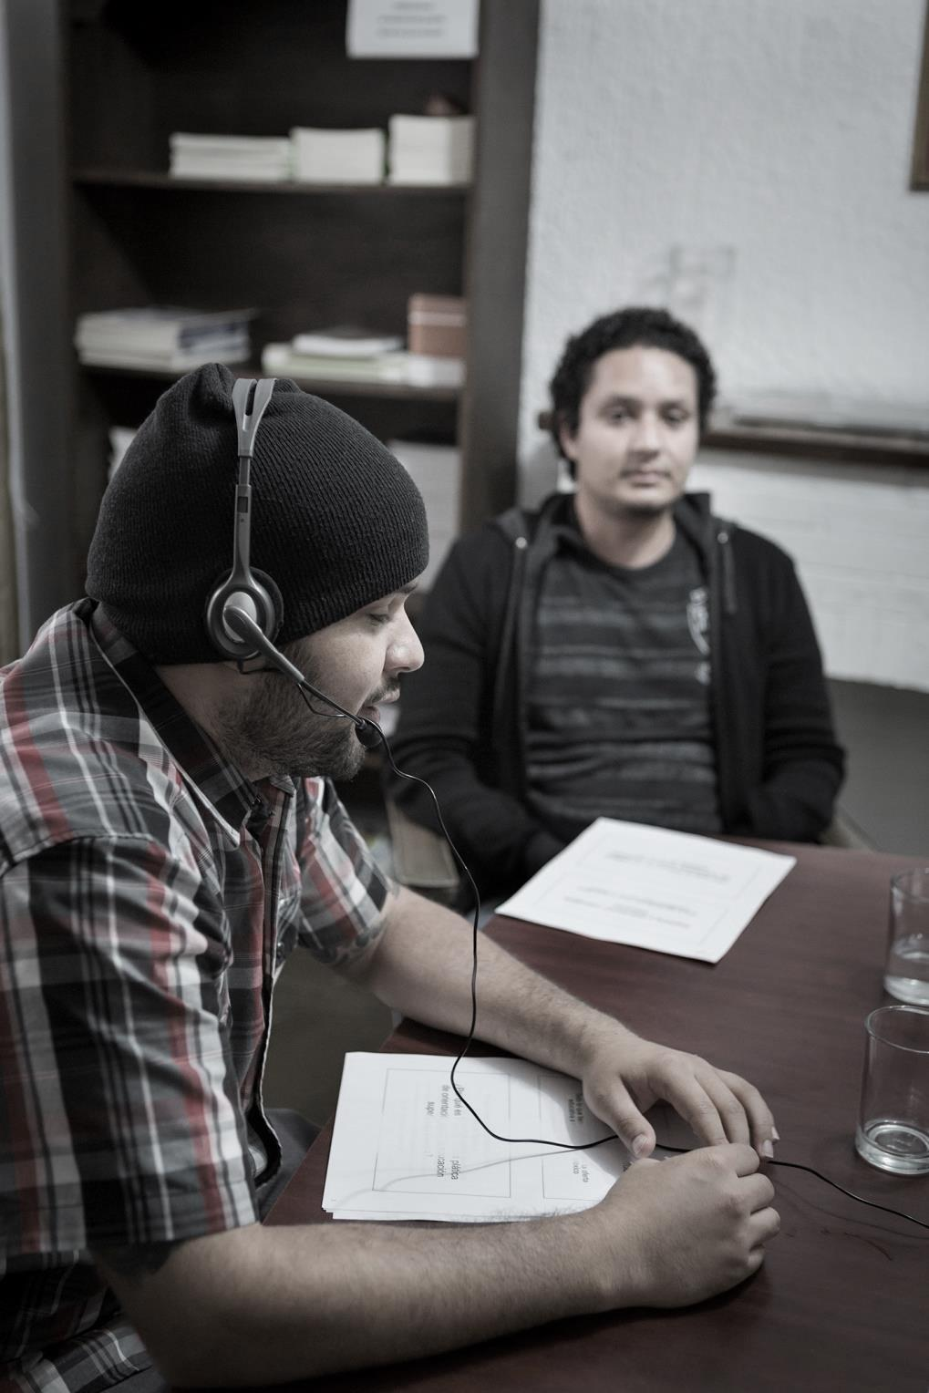
Samuel & Daniel Lopez
From:
Jalisco –– California, Missouri, Texas
Both work: Trans national “ Call center”
sitio web:
www.odamexico.org

Slide 6
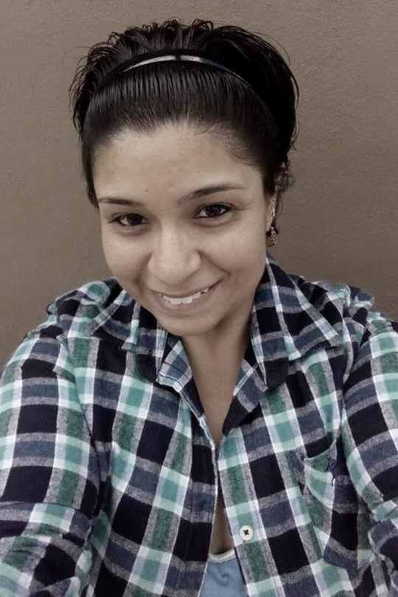
Viridiana Vargas
From:
Guanajuato – Idaho
“I would love to continue my higher education but at this moment I need to work.”

Slide 7
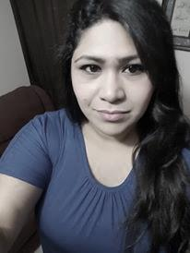
Sybil Mitchel Lozano
From:
Sonora – Arizona
supervisor @ Trans national Call Center

Slide 8
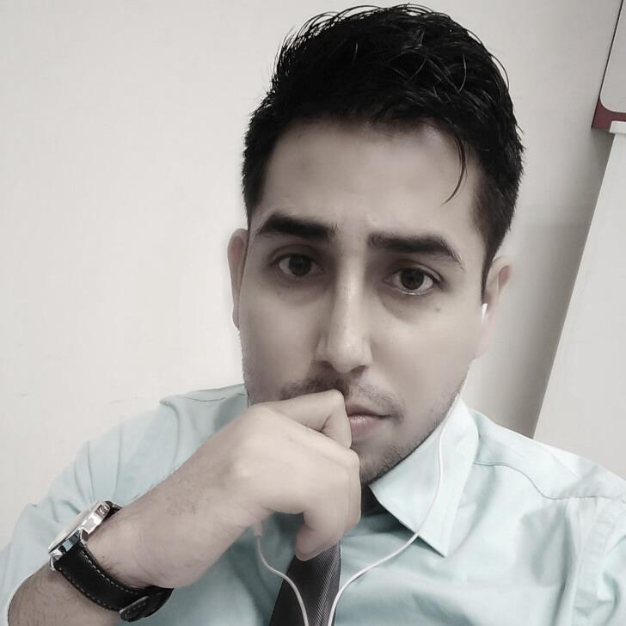
Enrique Rojas
From:
Morelos – Indiana
Major: IT Engineer
Work: trans national IT company.

Slide 9

Yoni Salgado
From:
Guerrero – Florida
“I am not currently studying because of economic issues.”

Slide 10
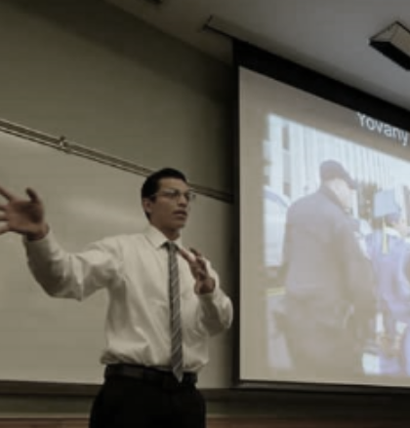
Yovany Diaz
From:
San Luis Potosi – Georgia
“The language limitation has been a barrier for me to continue studying and getting a job.”

Slide 11

Viridiana Chavez
From:
Guanajuato – Florida
work: transnational “call center”
Desires to become a teacher.

Slide 12

Victor Hugo Manuel
From:
Estado de Mexico– Nevada
Major: Foreign Languages
Works: English Teacher

Slide 13
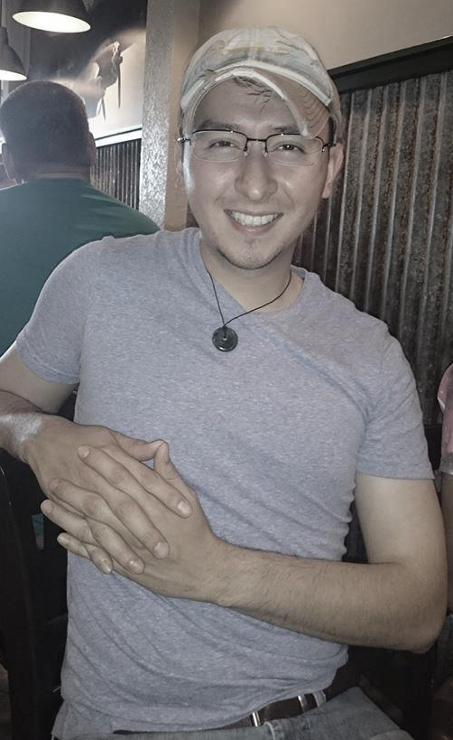
Victor Saucedo
From:
Chihuahua – Texas
16 years currently living in The US
Benefits from Executive Order 2012 “DACA”
Major: Computer Science

Slide 14
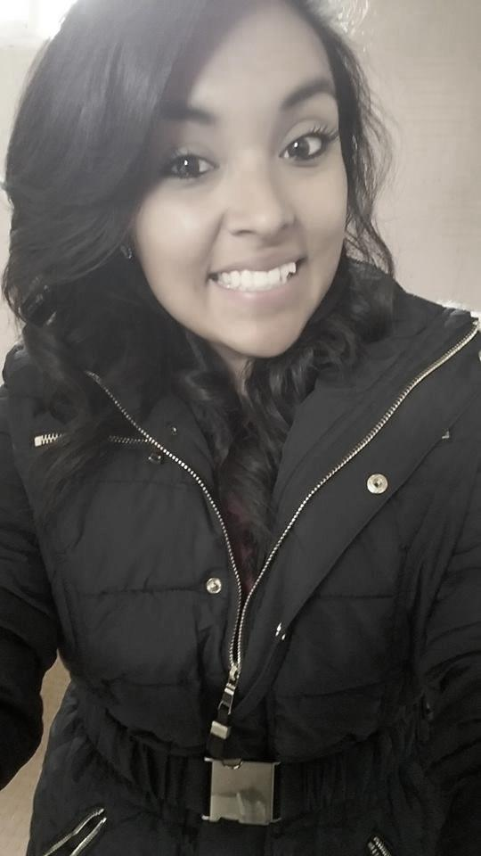
Selene Ramirez
From:
Michoacán – Indiana
Major: Educational psychology
Work: English Teacher

Slide 15
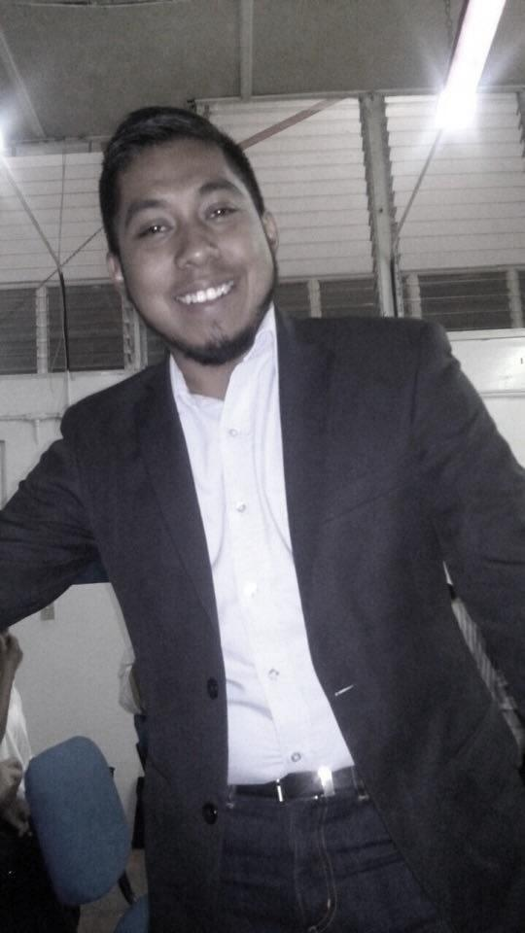
Pedro Magallon
From:
Guerrero – California
Major: Psychology
Work: online bilingual Interpreter

Slide 16

Rufino Santiz Diaz
From:
Chiapas – Georgia
Major: BA of English teaching

Slide 17

Valeria Aragon Gonzalez
From:
Mexico City – Florida
Major: International Business

